Slide 1
Teaching Pack – NHS Birthday 5 July 2017
We have created this ‘pick and mix’ resource to celebrate the NHS’s 69th birthday on 5 July this year. Please select the slides you feel are appropriate for your classes. Notes are included under the slides where appropriate, and all sources referenced. Slides 2-8 are suitable for primary age children from Y2/3 (with support) to Y6. Slides 2-12 are suitable for secondary age children up to Y13, particularly from slide 9.
Slide 2-3: What is the NHS?
Slide 4: The NHS as a British Institution, featuring London 2012 Opening Ceremony
Slide 5: What jobs can you think of within the NHS?
Slide 6: Life before and after the NHS, a short case study
Slide 7: Quiz time!
Slide 8: Wordsearch (printable resource)
Slide 9: International Comparisons – printable reading activity for secondary students. Suggested activity – highlight the positives and negatives.
Slide 10: One NHS, Many Nationalities
Slide 11: A quick look at ‘health tourism’
Slide 12: NHS campaigner groups. Suggested activity: discussion around why the campaign groups exist and what they may want to achieve.
©Louise Peace for Hands Off HRI

Slide 2
Celebrating 69 years of the NHS!
5 July 1948
The NHS
is born!
www.nhs.uk/NHShistory1948
On 5 July 1948, the Health Secretary Aneurin Bevan launched the NHS at Park Hospital in Manchester. It was a very ambitious plan to bring good healthcare to everybody. For the first time, hospitals, doctors, nurses, pharmacists, opticians and dentists are brought together under one umbrella organisation to provide healthcare services that are free for all.
The central principles are clear: the health service will be available to all and financed entirely from taxation, which is to say that people pay into it according to their means.
©Louise Peace for Hands Off HRI
Notes:
This information is taken from the NHS website which ised on the slide. Could lead to discussion about what taxation is and what paying ‘according to means’ actually means.
Source> http://www.nhs.uk/NHSEngland/thenhs/nhshistory/Pages/NHShistory1948.aspx

Slide 3
Principles and values that guide the NHS
that it meet the needs of everyone
that it be free at the point of delivery
that it be based on clinical need, not ability to pay
©Louise Peace for Hands Off HRI
Notes:
Source> http://www.nhs.uk/NHSEngland/thenhs/about/Pages/nhscoreprinciples.aspx
You may need to break down the language used above with your children, depending on age & ability.

Slide 4
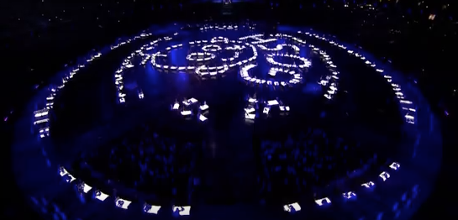
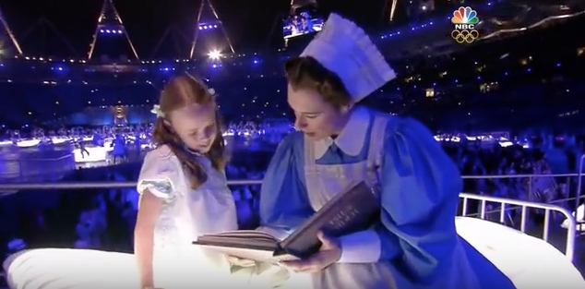
In the UK, we are rightly proud of our NHS. At the 2012 Olympic Games in London, our National Health Service was celebrated in the opening ceremony. It was watched by an estimated 900 million people around the world.
There is no other free at point of use health service like it in the whole of the rest of the world.
NHS segment from London 2012 Olympic Opening Ceremony (Mike Oldfield)
©Louise Peace for Hands Off HRI
Notes:
The video link at the bottom of the slide takes you to You Tube and is 11.26 mins long, you may just wish to play the first few minutes.
Source for viewing figures: http://uk.reuters.com/article/uk-oly-ratings-day-idUKBRE8760V820120807 and

Slide 5
How many jobs can you think of in the NHS?
Doctor
Surgeon
Midwife
Nurse
GP
Paramedic
Dentist
Chemist/Pharmacist
Admin Assistant
Optician
Healthcare Scientist Practitioner
Project Manager
Receptionist
Human Resources Advisor
Audio Typist
Bank Administrator
Radiographer
Healthcare Assistant
Occupational Health Therapist
Porter
Biomedical Scientist
Psychologist
Junior Doctor
Physiotherapist
Radiographer
Personal Assistant
Chef
Matron
Paediatrician
Consultant
Mental Health Nurse
Housekeeper/cleaner
Registrar
IT Specialist
Network Manager
Speech & Language Therapist
©Louise Peace for Hands Off HRI
Notes:
See how many the children can come up with – the bold blue titles are the most obvious. This slide is designed to show the huge range of jobs being done to look after people’s health. It is by no means an exhaustive list!

Slide 6
Britain before and after the NHS
My nan is 95 years old. She was 32 when the NHS was founded. I asked her to tell me about her experiences of Britain before and after a National Health Service. This is what she told me.
When we were little, you had to pay to see the doctor. He’d give you a treatment, then a bill. Lots of people didn’t go because they couldn’t afford it – you only really used the doctor if it was something serious. I remember my twin sister, Gladys, had a bad leg and she didn’t go to school for a year. She never saw a doctor – it was too expensive. We’d try and cure ourselves instead. Everybody had a home remedy for something. Doctors were different too: they didn’t care for you like they do now. Our doctor was a mean and snappy man. I had to get some medicine for my grandmother when she was ill once. He told me, ‘it’s not a doctor you need. It’s a vicar.’ I dreaded going to see him after that. My granddad didn’t have teeth or glasses, even though he had bad eyesight. He just couldn’t afford it. It was the same for everyone who was poor: if you couldn’t afford it, you didn’t get it.
1 of 2
©Louise Peace for Hands Off HRI
Notes:
Suggested activity – read the story aloud to your class (there are two pages) and ask them to imagine what it must have been like to not be entitled to free health care.
Source:
http://www.ukuncut.org.uk/blog/guest-post-britain-before-and-after-the-nhs/ This entry was posted May 23, 2011 by UK Uncut, a guest post by Ellie Mae O’Hagan. You can follow her on Twitter at @MissEllieMae.
You might want to read this to the children and lead into a discussion about what life might have been like for ordinary working families.

Slide 7
Quiz!
The NHS was founded on 5 July a. 1928 b. 1975 c. 1948
It stands for: a. Natural Health Service b. National Health Service c. National Health Situation
It was founded by: a. Aneurin Bevan b. The Queen c. Theresa May
It is paid for by means of: a. donations / fundraising b. the national lottery c. taxation
The correct spelling is: a. Pharmasist b. Pharmacist c. Pharmecist
Choose the incorrect answer. Before the NHS, people a. had to have enough money to pay to see a doctor b. could see a doctor when they wanted c. were much more likely to die of disease and poor healthcare
©Louise Peace for Hands Off HRI

Slide 8
Happy Birthday NHS!
T D H D O D T R N S I E S A C
H S L A S H O S E U C A P N I
T M I W P T O R I N R P O E D
L P O C C P V S A T O S W U E
A R V O A I Y L P I N N E R M
E E D D C M U B N I Z E I I A
H S X E Q B R T I P T G D N R
A C B L M X M A Y R X A K R A
R R A A P E V J H P T Y L S P
C I L Q N E L M L P C H T N O
J P K T N A T I O N A L D H J
B T E R A C H T L A E H K A Q
S I X T Y N I N E Y E A R S Y
N O E G R U S B E V A N U Q C
C N S X M U Q P H C S Q S H V
AMBULANCE ANEURIN BEVAN NURSE DENTIST
DOCTOR HEALTHCARE HOSPITAL SURGEON
PARAMEDIC PHARMACIST PRESCRIPTION APPOINTMENT
HAPPY BIRTHDAY NATIONAL | HEALTH | SERVICE SIXTY NINE YEARS
©Louise Peace for Hands Off HRI
Notes:
Printable resource

Slide 9
International comparisons
In comparison with the healthcare systems of ten other countries (Australia, Canada, France, Germany, Netherlands, New Zealand, Norway, Sweden, Switzerland and USA) the NHS was found to be the most impressive overall by the Commonwealth Fund in 2014.
The NHS was rated as the best system in terms of efficiency, effective care, safe care, coordinated care, patient-centred care and cost-related problems. It was also ranked second for equity.
However in the category of healthy lives (10th), the NHS fared less well.
Current health expenditure in the UK was 9.78 per cent of GDP in 2015. This compares to 16.91 per cent in the USA, 11.08 per cent in Germany, 11.01 per cent in France, 10.76 per cent in the Netherlands, 10.59 per cent in Denmark, 10.16 per cent in Canada, 9.05 per cent in Italy and 9.00 per cent in Spain.
Current expenditure per capita (using the purchasing power parity) for the UK was $4,015 in 2015. This can be compared to $9,451 in the USA, $5,343 in the Netherlands, $5,267 in Germany, $4,943 in Denmark, $4,614 in Canada, $4,415 in France, $3,272 in Italy and $3,153 in Spain.
The UK had 2.8 physicians per 1,000 people in 2015, compared to 4.1 in Germany (2014), 3.9 in Italy (2014), 3.8 in Spain (2014), 3.5 in Australia (2014), 3.4 in France, 3.0 in New Zealand and 2.6 in Canada (2014).
The UK had 2.7 hospital beds per 1,000 people in 2014, compared to 8.2 in Germany, 6.2 in France, 3.0 in Spain, 2.8 in New Zealand and 2.7 in Denmark.
©Louise Peace for Hands Off HRI
Notes:
Secondary Pack.
Handout. Suggested activity: Highlight the positives in one colour and negatives in another colour.
Source> http://www.nhsconfed.org/resources/key-statistics-on-the-nhs (November 2016)

Slide 10
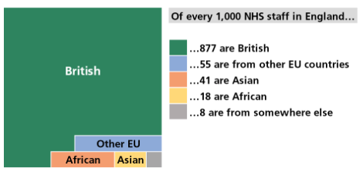
One NHS, Many Nationalities - Staff
©Louise Peace for Hands Off HRI
Notes:
Source> http://researchbriefings.parliament.uk/ResearchBriefing/Summary/CBP-7783 (10 April 2017)
Use to trigger a discussion around immigration, discuss how people from outside Britain are contributing in a positive way to our healthcare provision within the NHS.

Slide 11
Health Tourism – Is it really a problem?
What do we mean by ‘health tourism’?
How much of a problem do you think it is for the NHS?
Visit this website to find out the facts about health tourism.
Fact check: Health tourism costs 0.3% of NHS spending, vastly less than many people imagine.
©Louise Peace for Hands Off HRI
Notes:
Source: https://fullfact.org/health/health-tourism/
Fullfact – The UK’s independent fact checking charity

Slide 12
Local Campaign Groups
999 Call For The NHS
Hands Off HRI
Health Campaigns Together
Keep Our NHS Public
NHS Detectives
Let’s Save Huddersfield A&E
Save Slawit Health Centre SOS
Save Our Accident & Emergency Dewsbury
©Louise Peace for Hands Off HRI
Notes:
Discussion – why do these campaign groups exist? What do you think they trying to achieve? What do you think about this?

